Slide 1
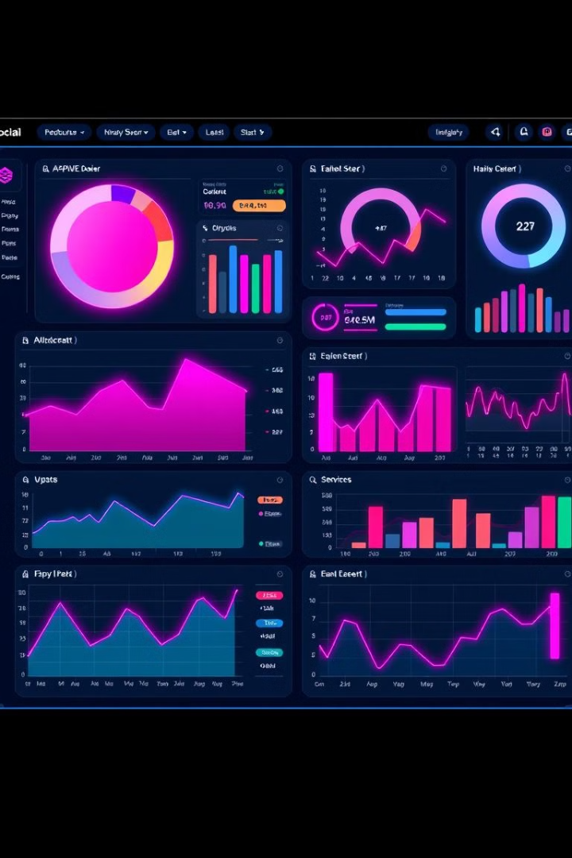
Power BI Dashboard for Car Sales Analysis
Visualizing and analyzing car sales data using Power BI dashboard.

Slide 2
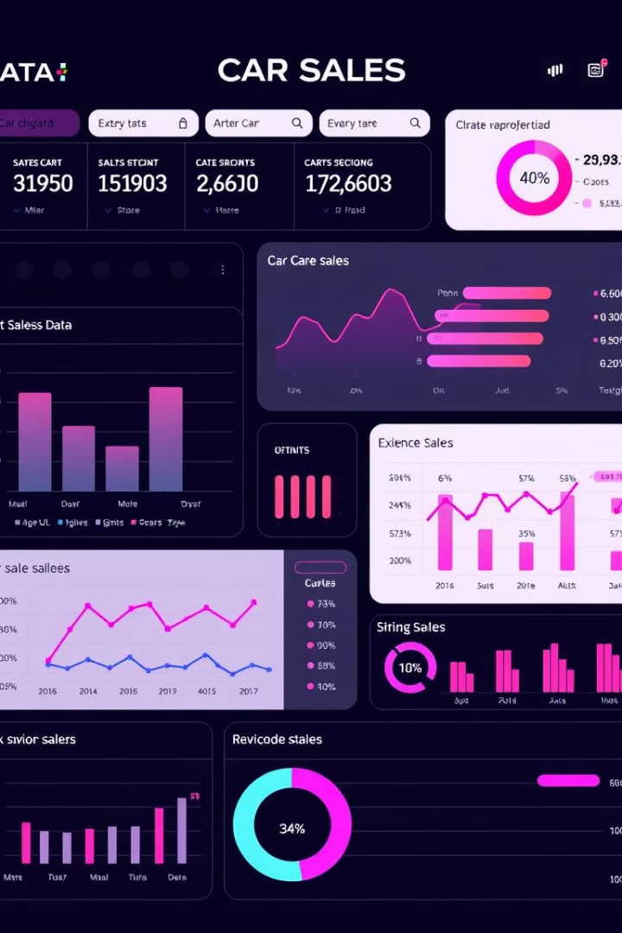
Problem Statement
Limited Insights
Manual Reporting
Difficult to identify key sales trends and patterns.
Time-consuming and prone to errors.

Slide 3
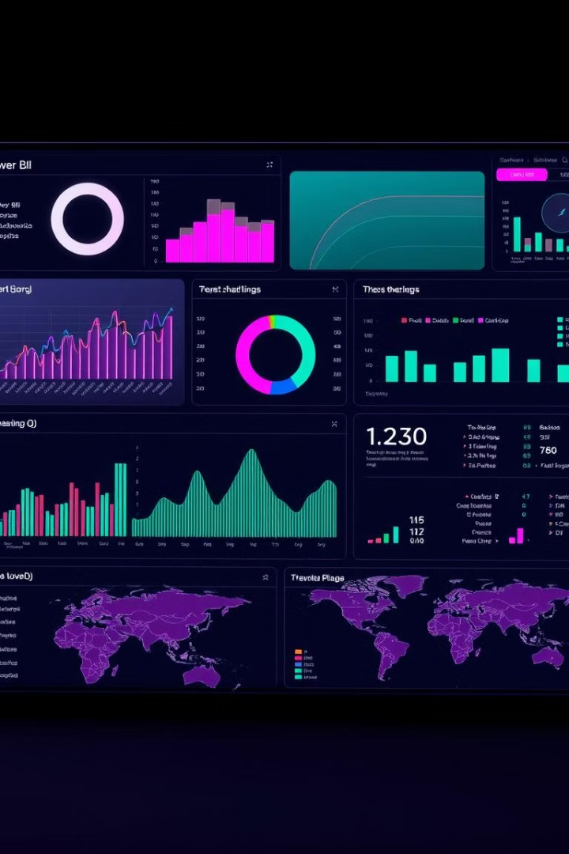
Solution: Power BI Dashboard
1
Interactive Visualizations
2
Automated Reporting
Save time and increase accuracy.
Gain deeper insights into sales performance.
3
Data-Driven Decision-Making
Identify opportunities and address challenges.

Slide 4
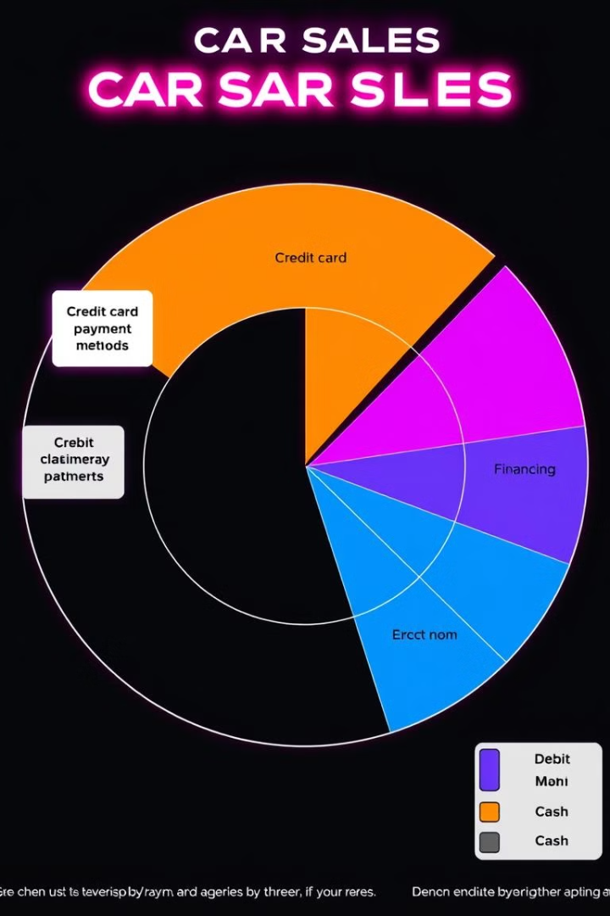
Sales by Payment Method
Pie chart showing the percentage of sales by different payment methods.

Slide 5
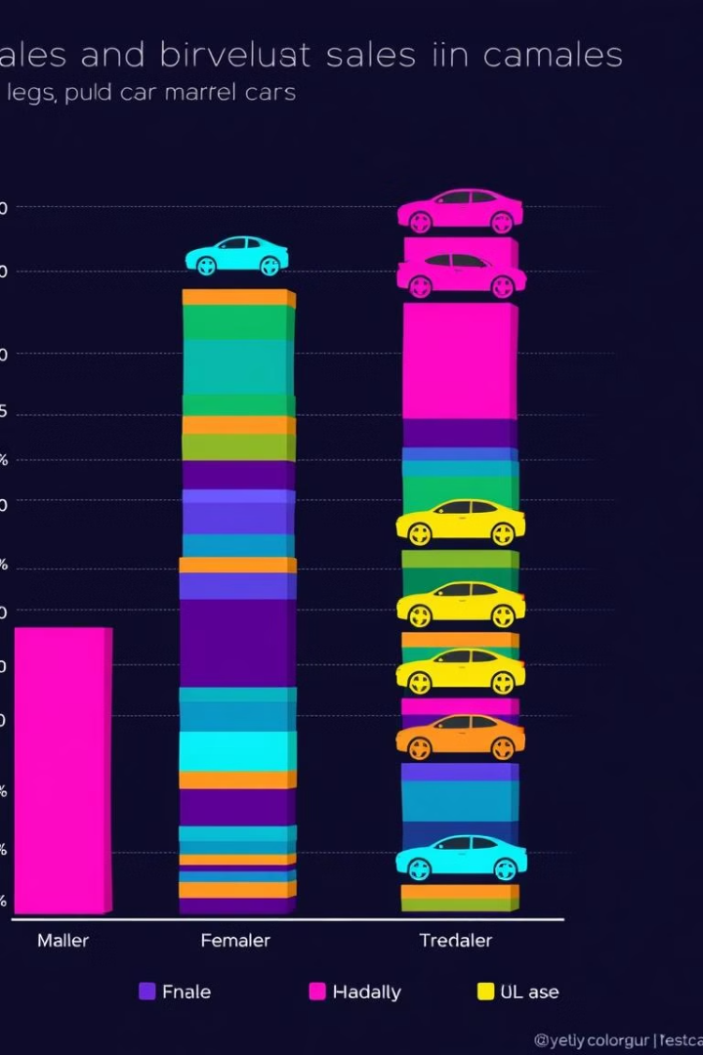
Sales by Car Make and Gender
Stacked column chart analyzing sales performance for different car makes across genders.

Slide 6
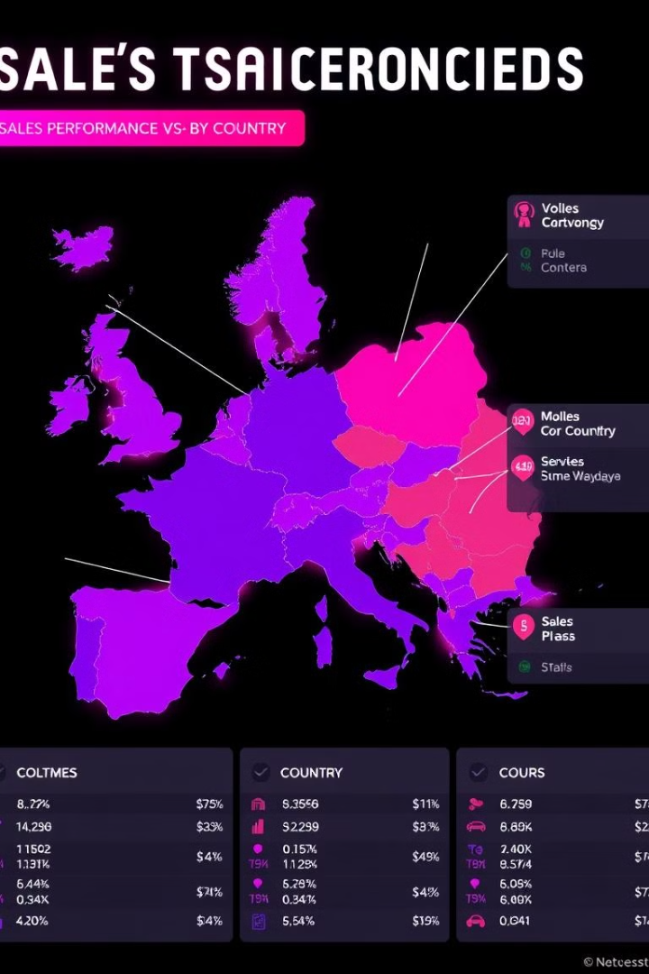
Sales Performance by Country
Map visualization showing the sales distribution across different countries.

Slide 7
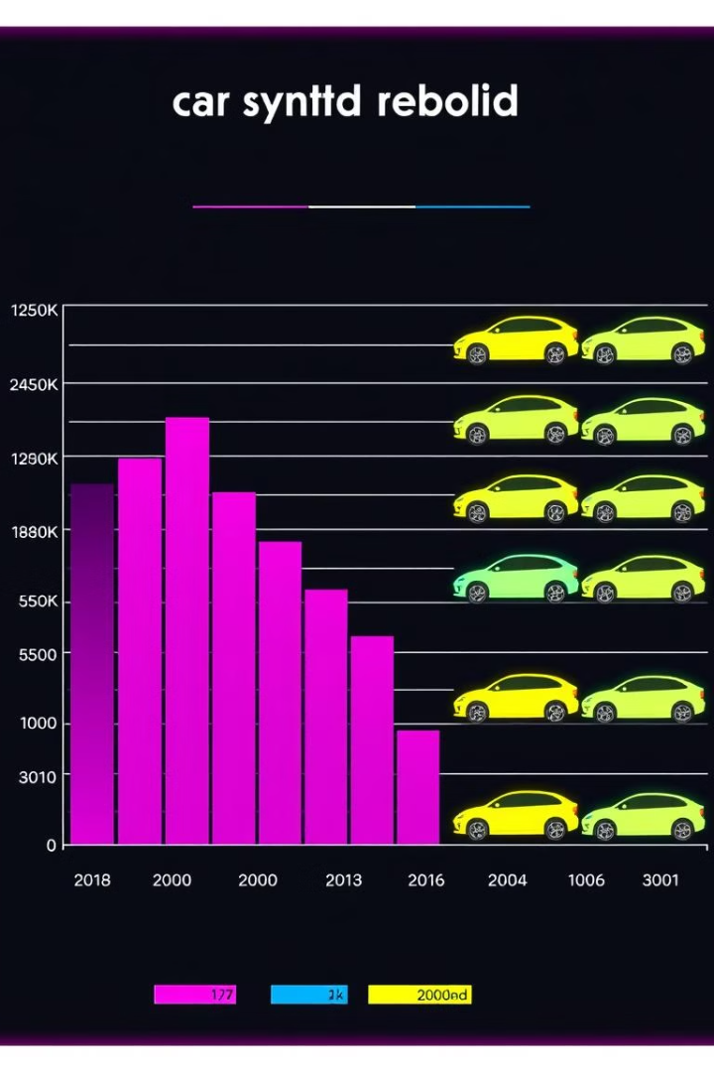
Sales by Car Type
Clustered bar chart visualizing the quantity of cars sold by different types.

Slide 8

Conclusion
The Power BI dashboard provides actionable insights to drive sales growth through improved strategies and processes. It empowers data-driven decision-making, enhancing efficiency and accuracy in sales analysis. This ultimately leads to increased revenue and a deeper understanding of customer behavior.

